Slide 1
Improving Biodiversity Conservation in Ganghwa Mud Tidal Flat, Korea
Reducing development stress and promoting sustainable exploitation of YSLME
Gyung Soo Park
Department of Marine Biotechnology
Anyang University, Incheon 417-833, Rep of Korea

Slide 2
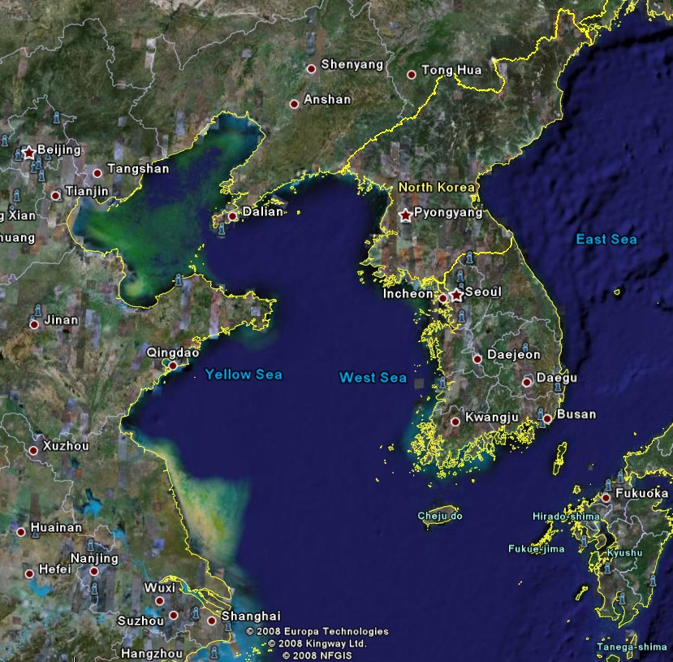
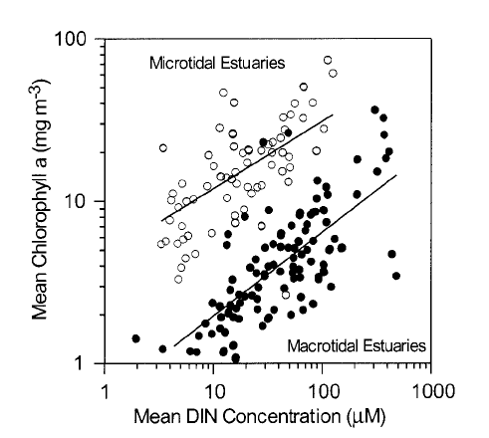
Yellow Sea Large Marine Ecosystem
 | West Coast (China) | East Coast (Korea)
Costal lines | Straight | Meandering
Tidal amplitude | Low 1-2m | High Max 13m
Rep Habitat types | Sea grass bed | Mud tidal flat
Turbidity | Low | High
Bohai Sea
Ganghwa
(Monbet 1992)

Slide 3
Steps for the demonstration site selection
Habitat classification
Review the data from national reports, WWF, YSEPP and existing references
Identified 10 Ramsar habitat types from the 250 unit habitats in the west coast of ROK
Selection of representative habitat
Identify the best example of each representative habitat type
Selection of demonstration site
Developed habitat selection criteria for quantification
Selection of critical habitats
Identify the major habitat types by the Ramsar Coastal Wetland Classification
Identified 10 types of Ramsar coastal habitat types
A total of 11 criteria selected and score for each representative habitat
Estuary, tidal flat and bay were selected as critical habitats in the west coast of ROK
  Based on the ecological importance and environmental issues
  Ganghwa tidal flat selected as demo activities
  Activities in improving biodiversity at the demo site

Slide 4
Selection of demonstration site as
Ganghwa Southern Tidal Flat (GSTF)
North Korea
- Located in the Han River estuary
One of the five largest tidal flat
in the world
Designated as National
Heritage # 419 as nesting
area for black faced spoonbill
Part of MPA (Ongjin-Jangbong
tidal flat)
Important habitats for the
migratory fish and birds
Production of shellfish fisheries
Diverse halophytes
Physical and ecological buffering
between fresh and marine
environment
Water transportation before
Korean war, Blocked in the
north
Well connected to the
freshwater channel for
farmland irrigation
Ganghwa Is
HanRiver
Gangwha Tidal Flat
Incheon Air Port

Slide 5
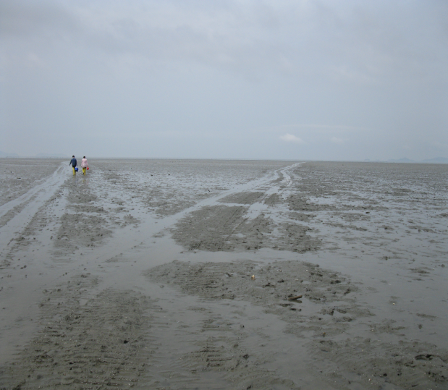
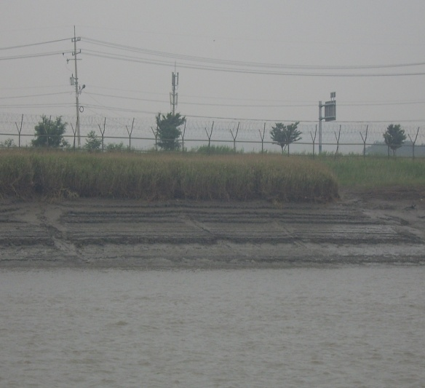
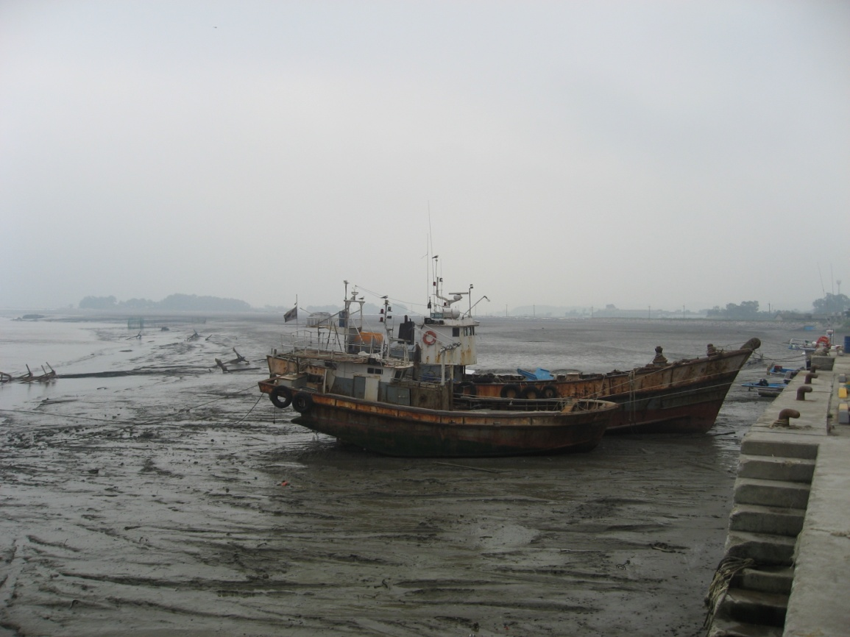
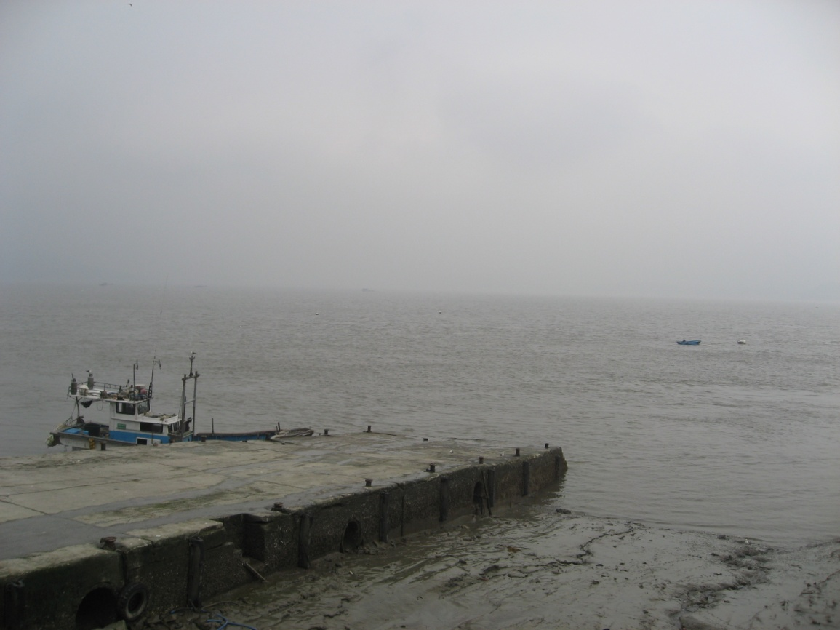
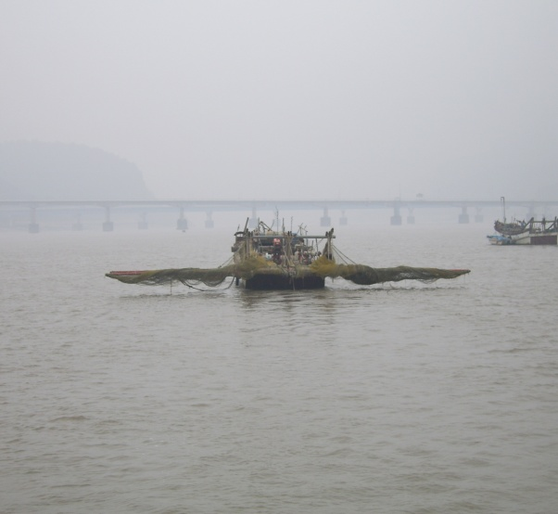
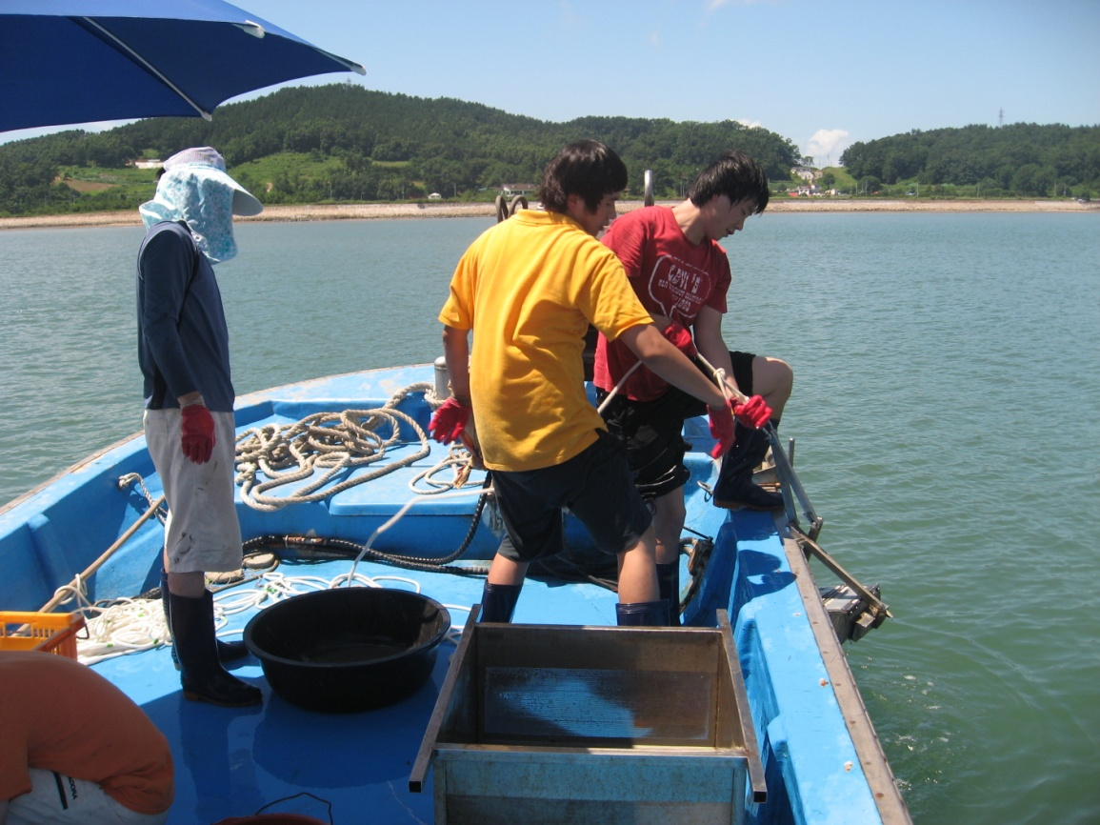
Selection of demonstration site GSTF

Slide 6
Activities in demonstration sites
Establishment of networking for demo activity
Estimation of pollution status and pollution loadings
- water and sediment quality. Nutrient& COD loadings
Identification of relationship between pollution and benthic biodiversity
- organic pollution and benthic biodiversity. Microcosm study
Identification of environmental issues and threatening factors
- pollution and development plans
Reviewing existing plans and establishment of new environmental management plans
- establishment of new management plans to meet the target
Public awareness and training of stakeholders
- identify the targets and develop programme for education
Evaluation of effectiveness of biodiversity conservation

Slide 7
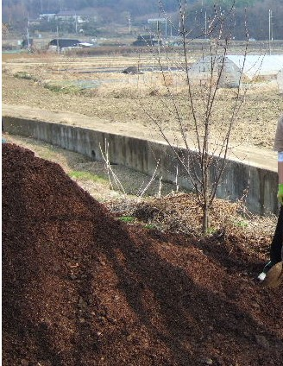
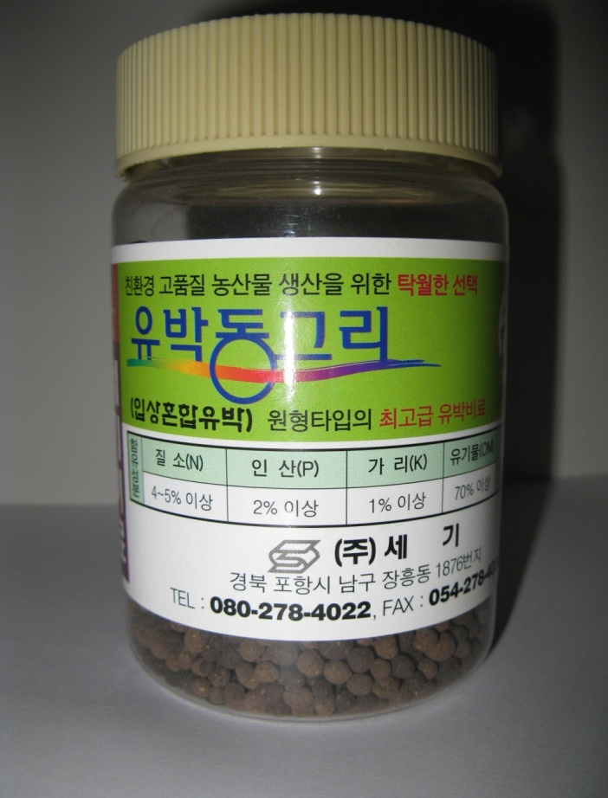
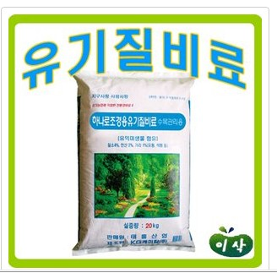
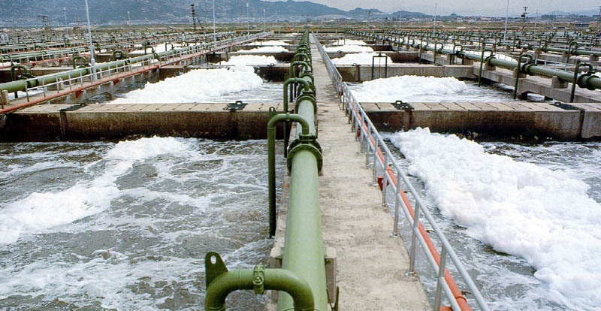
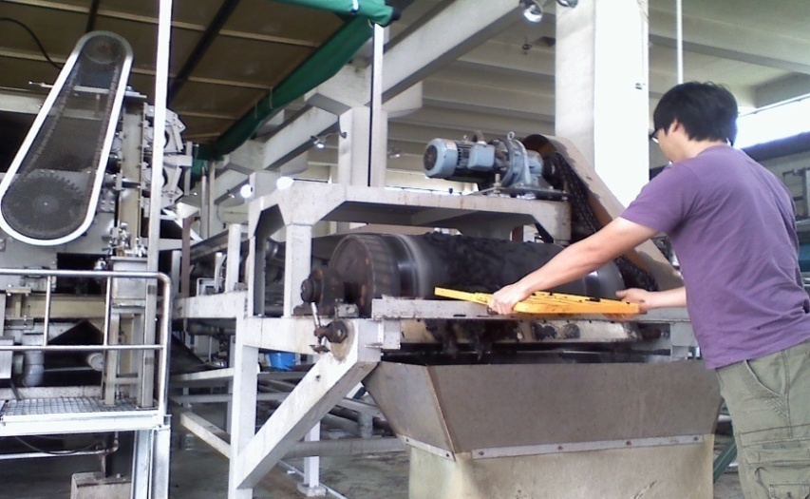
Experimental Design
Field survey to identify the benthic biodiversity
Microcosm study to id relationship btw OP&biodiv
Artificial organic pollutants : compost. Org fert, and sewage sludge
Identification of changes in macro/ meiobenthos
Bead type organic fertilizer as dissolved organic pollutant
Compost as debris type organic pollutant
Sewage sludge for sewage pollutant

Slide 8
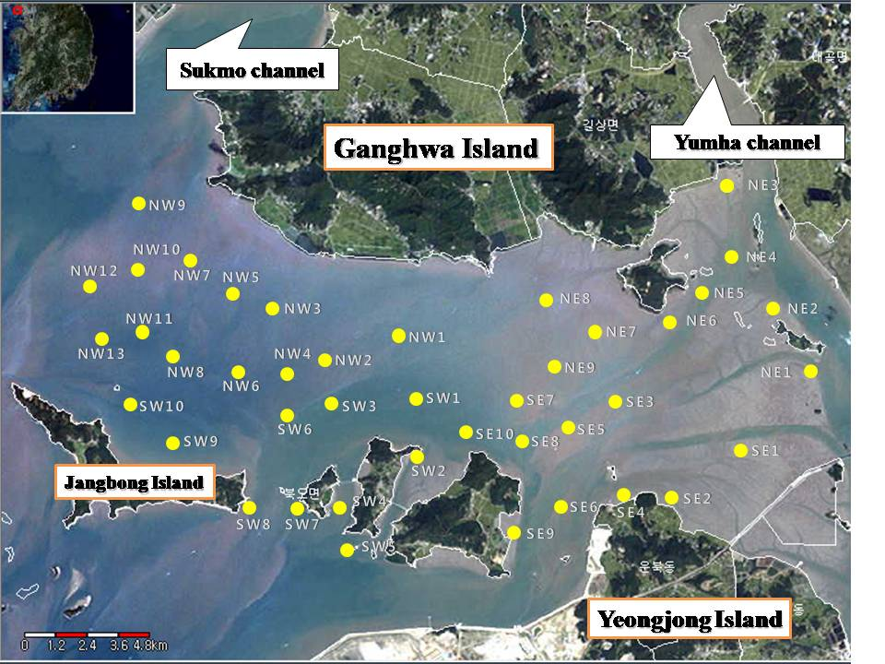
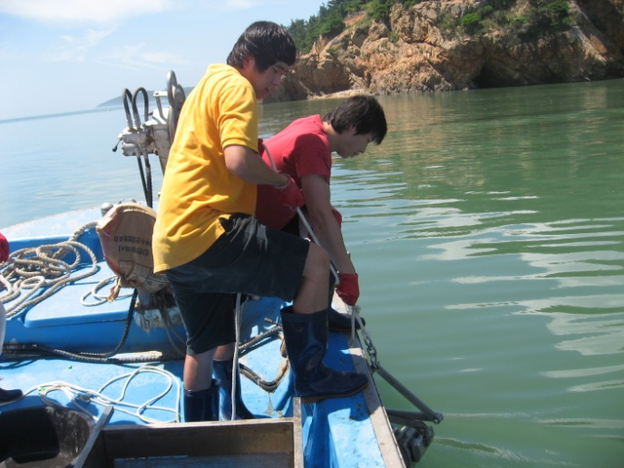
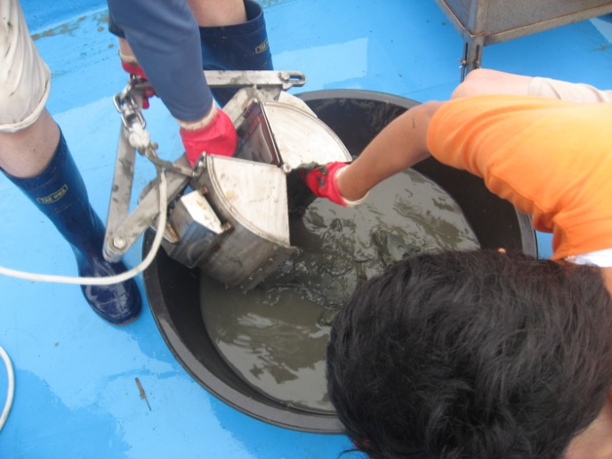
Field survey on benthic biodiversity estimation in GSTF (Jul-Aug, 2008)

Slide 9
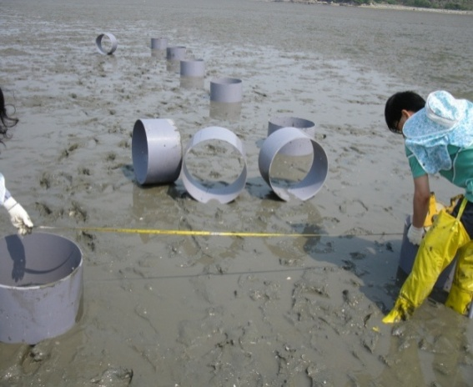
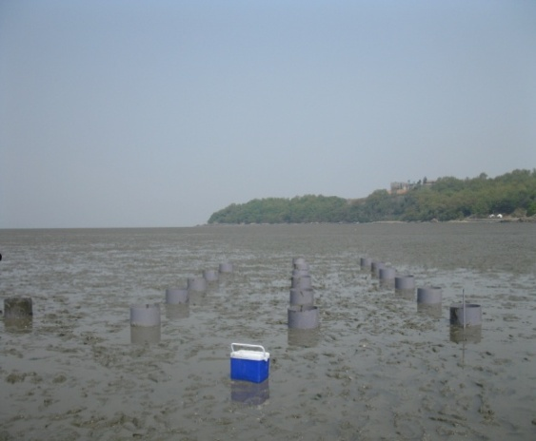
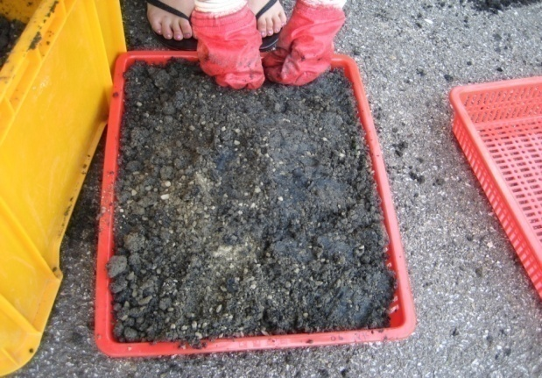
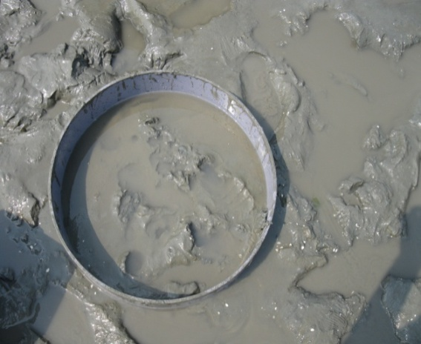
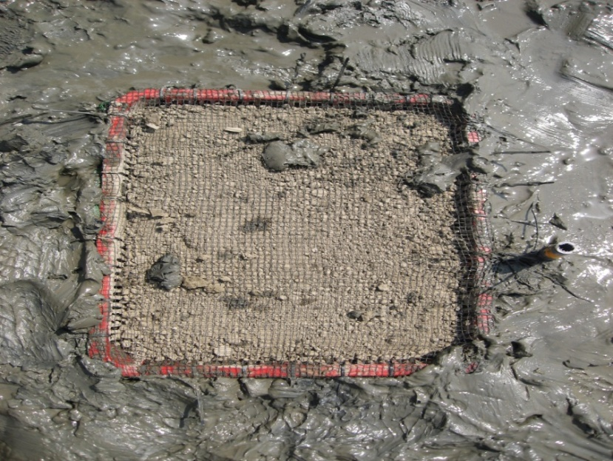
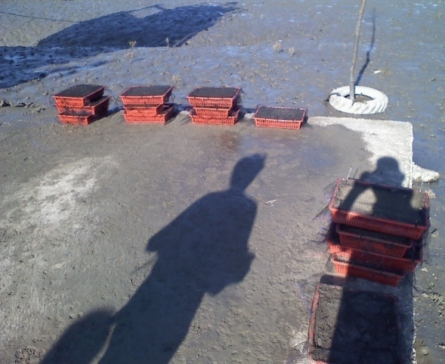
Microcosm study for relationship between pollution and biodiversity

Slide 10
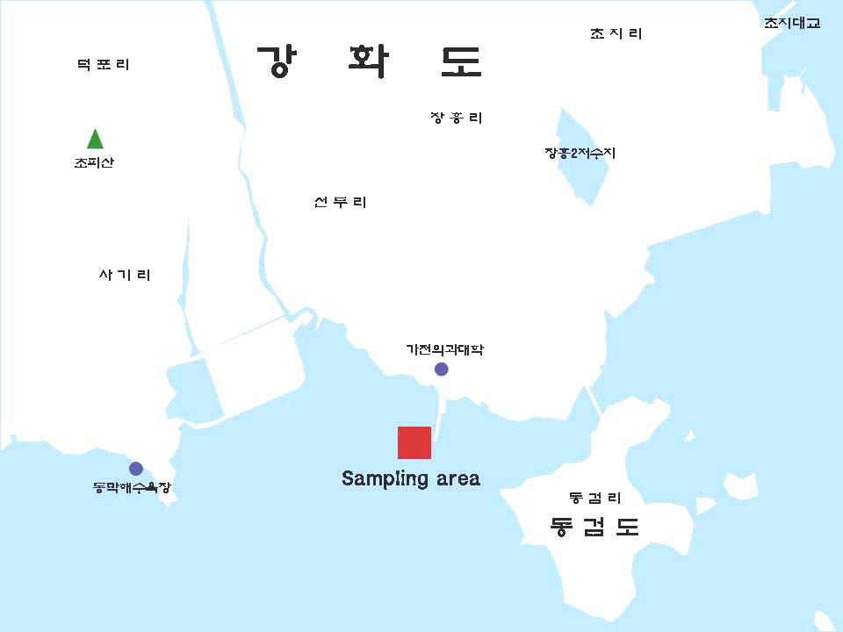
Implanting
microcosm
on the tidal
mud flat
Gangwha Island
Domestic sewage
Livestock waste
Dyeing waste
Industrial waste
Mixed waste
1%
5
10
1
5
10
1
5
10
1
5
10
1
5
10
1%
5
10
1
5
10
1
5
10
1
5
10
1
5
10
1%
5
10
1
5
10
1
5
1
1
5
10
1
5
10
BackGround
Control

Slide 11
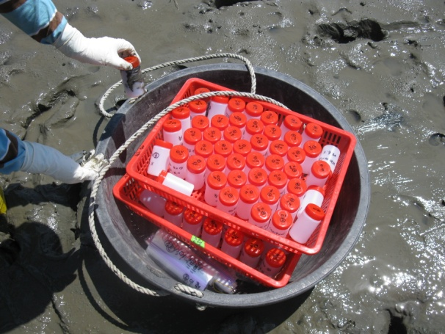
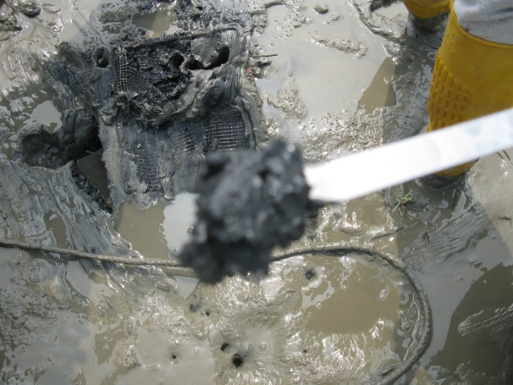
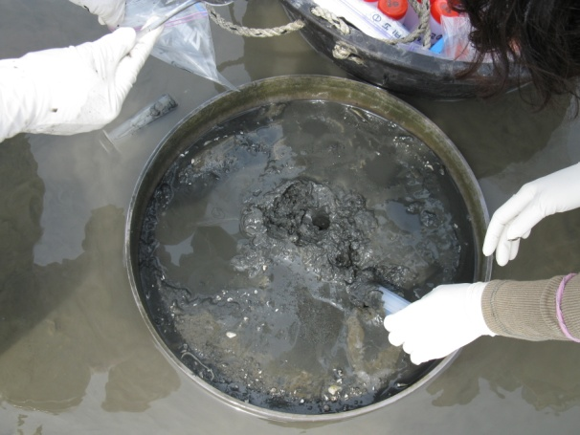
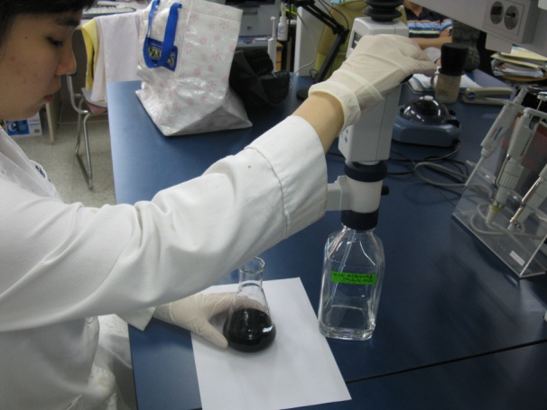
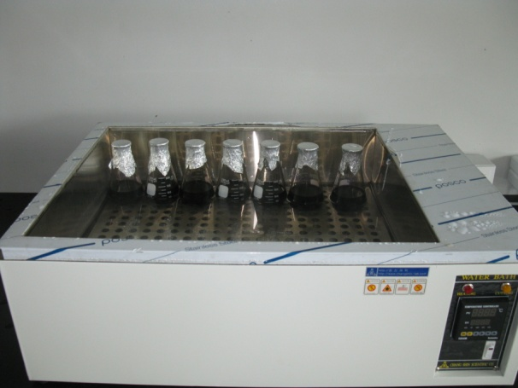
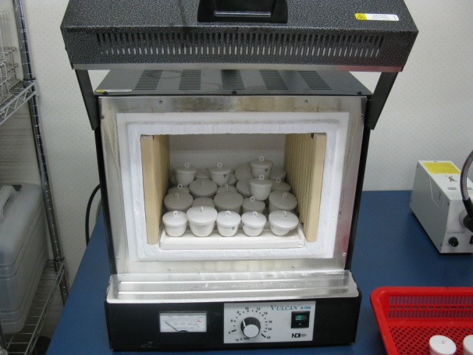
Samplings and analysis

Slide 12
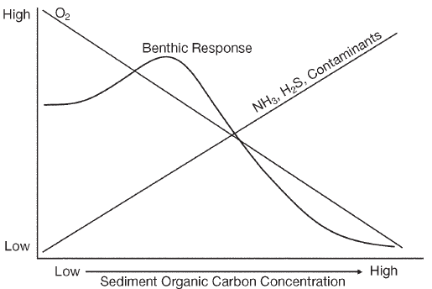
Organic pollution and benthic response
n=42 stations surveyed in Jul-Aug 2008
Conceptual Model
Application on GSTF

Slide 13
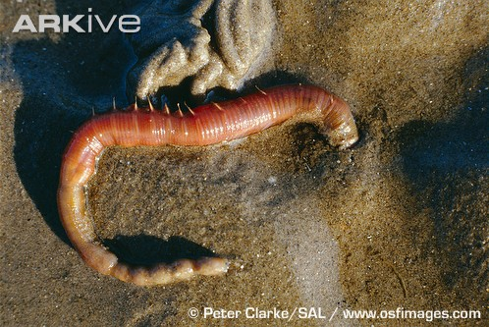
Species composition of macro-benthos in microcosm exposed to sewage sludge
<Number of species >
<Number of individuals>
<Biomass>

Slide 14
Changes in number of macro-benthos species exposed to sewage sludge

Slide 15
Changes in number of macro-benthos individuals exposed to sewage sludge

Slide 16
Comparison of macro-benthos community indices exposed to different sludge types

Slide 17
Decrease in macro-benthos community indices exposed to sewage sludge
Unit :%
Sludge types/ Community indices | No of species | No of individuals | Species diversity
Domestic waste | 20.8 | 14.5 | 26.7
Livestock waste | 33.3 | 17.4 | 55.2
Dyeing waste | 37.5 | 17.4 | 57.9
Industrial waste | 41.7 | 20.3 | 63.0
Mixed waste | 20.8 | 10.1 | 22.1
AVG±SD | 30.8±9.6 | 15.9±3.8 | 45.0±19.1
O 70% decrease in number of species in treatment
groups compared to control and background level
O 84% decrease in number of individuals and 55% decrease
in species diversity

Slide 18
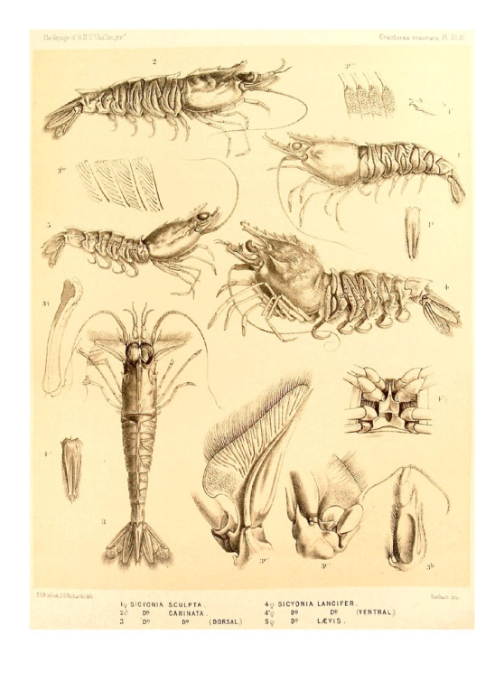
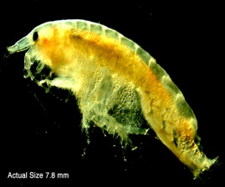
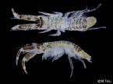
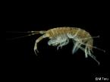
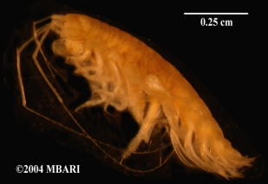
Comparison in macro-benthos species composition between compost and organic fertilizer
Organic fertilizer
(dissolved)
Compost
(debris)

Slide 19
Relationship sediment COD and macro-benthos density (waste treated)
P<0.05

Slide 20
Relationship ignition loss and macro-benthos density(waste treated)
P<0.05

Slide 21
Relationship COD/IL and macro-benthos (compost and organic fertilizer treated)
COD (mg/L)
Ignition loss (%)
Individuals/0.2m²
P<0.05
P<0.05
Wet weight (gWWt)
P<0.05
P<0.05
Concentration (mg/L)
Concentration (%)

Slide 22
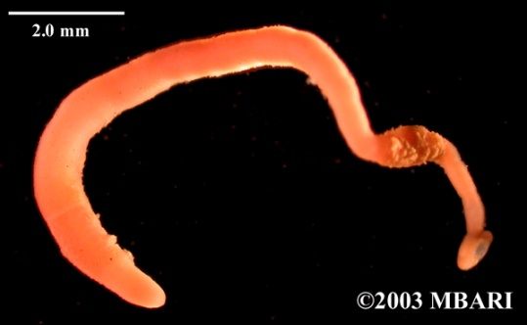
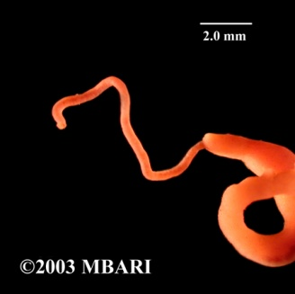
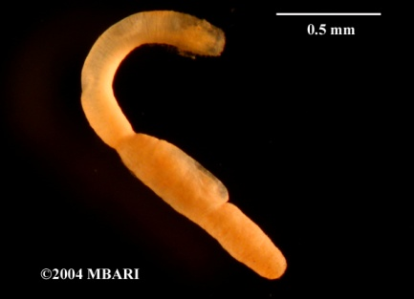
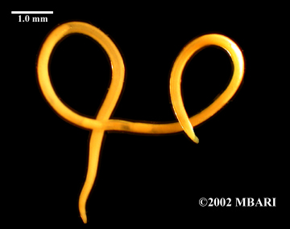
Species composition of meio-benthos

Slide 23
Decrease in meio-benthos species with the increase in waste treatment
Oct 2008 sample
Nov 2008 sample
Number of species
Industrial waste
Livestock waste
Domestic sewage
Leather processing waste
control/ background

Slide 24
Decrease in meio-benthos density with the increase in waste treatment
581 1765 1385
Oct 2008 sample
Nov 2008 sample
Density (inds/10m²)
Industrial waste
Livestock waste
Domestic sewage
Leather processing waste
control/ background

Slide 25
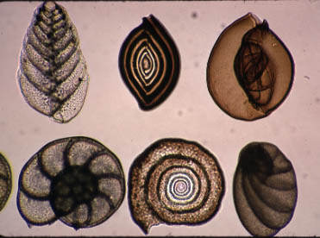
Relationship between COD/IL and meio-benthos
◀ COD
P<0.05
P<0.05
◀ IL
P<0.05
P<0.05

Slide 26
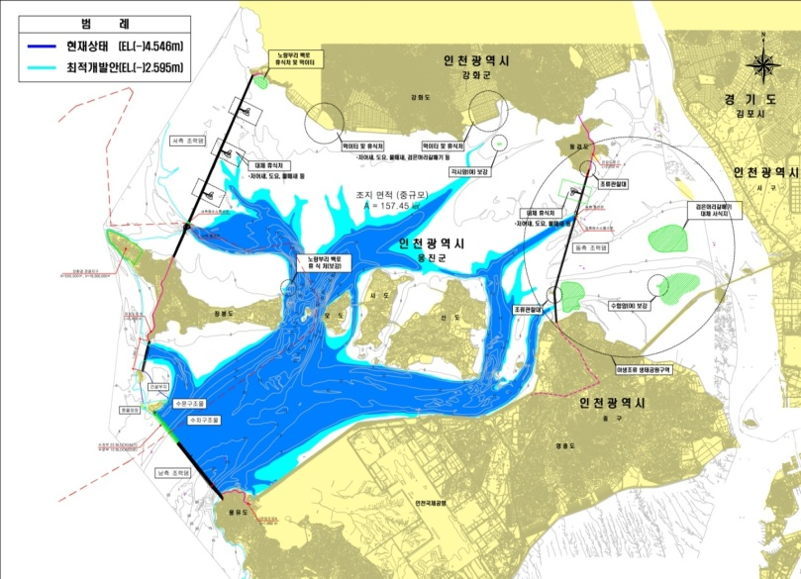
Major environmental issues and development plans in the GTF
Nutrients and organic pollution
Pollution loadings from domestic sewage and land use around the tidal flat
Solid wastes input through Han River and coastal area of the mud flat
Two tidal power plant plans - Ganghwa and Incheon TPP
영종도 준설토 투기장

Slide 27
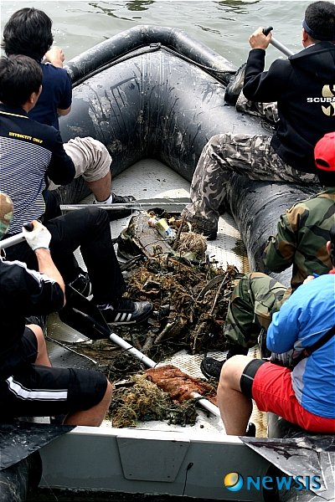
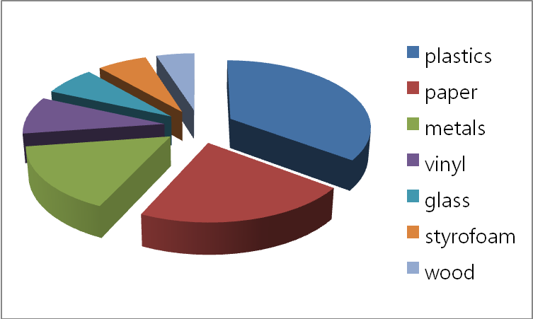
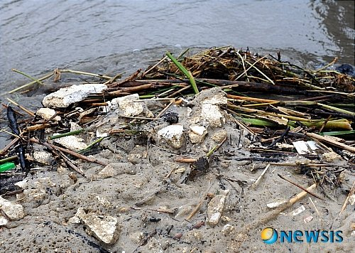
Marine solid waste in GSTF
Location | Year 2004
 | Production of solid waste | Treated | Untreated
Total | 87,493 | 28,694 | 58,798
Incheon | 55,632 | 4,536 | 51,096
Jeonnam | 15,352 | 9,732 | 5,620
Gyungnam | 4,358 | 4,029 | 329
Jeju | 3,992 | 3,862 | 130

Slide 28
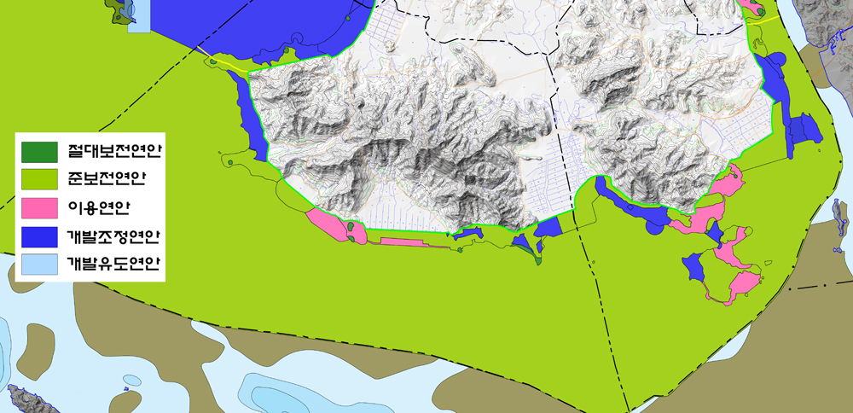
Reviewing and establishment of new environmental management plans
Absolute conservation area: Cultural heritage sites, Dongmak Beach
Semi-conservation area: Ganghwa Tidal flat and offshore, uninhabited islands, coastline, grade A conservation forest region based on national land environment quality test
Development area: forest and agricultural land under management region, Villages and management areas of Dongmak ri. Jangheung ri, Yeocha ri, and Janghwa ri
Development adjustment area: Choji aquavillage, Hangsando development area, Sundoo ri pension area, natural garden proposed area, fishing harbors, Janghwa ri resort proposed site,
Coastal zoning of Ganghwa area

Slide 29
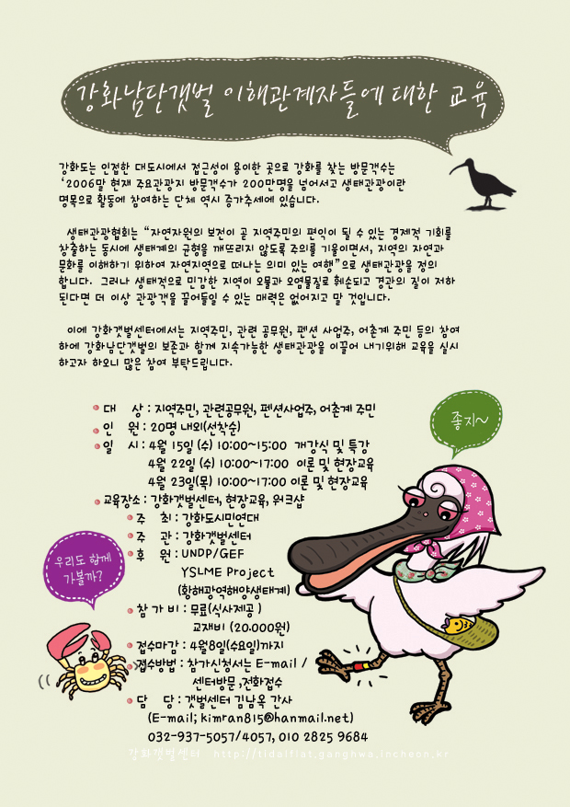
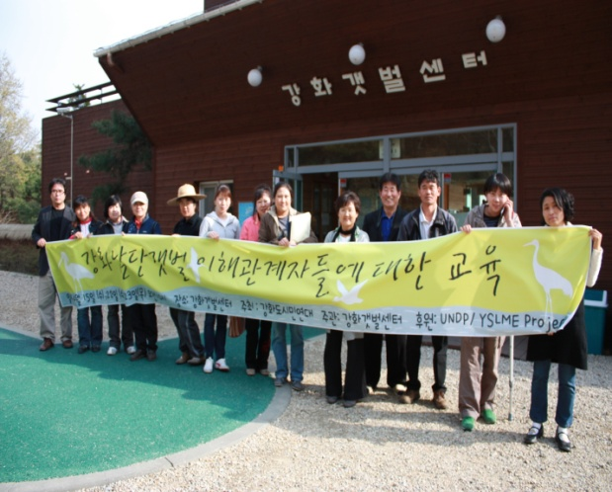
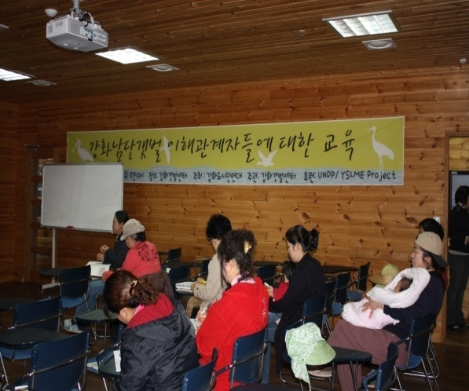
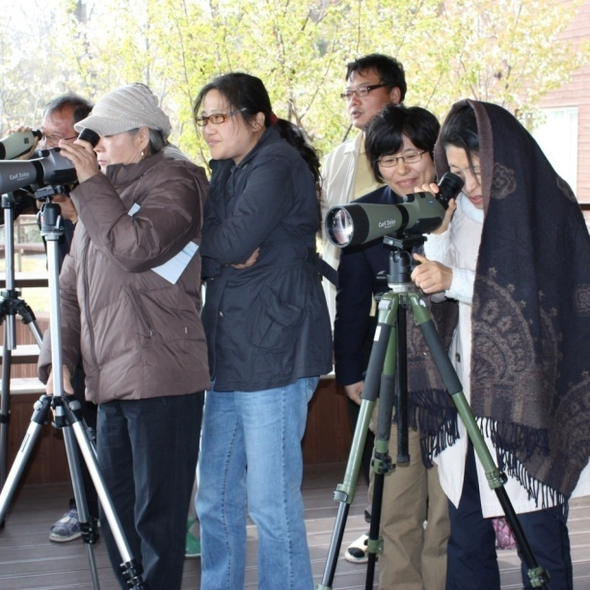

Stakeholder training

Slide 30




Public Awareness Activities
▶Conservation of black faced spoonbill
- 15 types of stickers
- Pocket notebook (2,000)
- Black faced spoonbill banner (20)
▶ Exhibition for water birds
▶ Booklet for the mudflat monitoring and
biodiversity of water birds

Slide 31
Suggestions to stakeholders and governments
Targets | suggestions
Han river catchment basins | Control of total pollution loading and tributary management to reduce pollutant input
Incheon City | Control on domestic sewage input and nonpoint source of pollutant from land use
Ganghwa County | Re-zoning of GSTF form semi to absolute conservation area Establishment of special committee for natural resource conservation
Gimpo City | Control of non-point source pollutants from land use
MLTM (Marine Affairs) | Establishment of guidelines for the MPA designation and management Establishment of national integrative environmental management system btw terrestrial and marine environment by ME and MLTM Reinforcement of “Wetland Conservation Act”
Min of Environment | Establishment of national integrative environmental management system btw terrestrial and marine environment by ME and MLTM Reinforcement of “Wetland Conservation Act”
CHA | Reinforcement of “National Heritage Conservation Act”
Research sector | Development of policies in addition to accumulation of scientific data
NGO sector | Systematic and science based approaches in argument

Slide 32
Lessons learned
Importance in science based evidence and approaches – more persuasive
Networkings btw local and central government
- communication on local and central government
Community based approaches (bottom-up)
- local support is critical for implementation of plans
International cooperation in sharing experience

Slide 33

Acknowledgements
Funding from UNDF/GEF YSLME Project & MLTM
Dr. KH Choi/Dr. SM Lee/Dr. SJ Yoon
Mr. SM Lim/Mr. SR Kim/Dr. YK Lim/Dr. WK Jang
Ms. JS Jung and students
Thank you!

